Slide 1
Capstone Project DA
Data Scraping and Analysis using Python

Slide 2
Data Scraping:
Technique to collect the data from internet site for analysis. It is useful in checking what product’s optimal price should be and compare the similar products to identify the best suitable as per requirement.
In this case we are going to scraping the data from Flipkart.com

Slide 3
Data Scraping
Libraries Required for Data Scraping:
Data Scraping is done using BeautifulSoup. It helps to extracts the html from the web page and we can store it. Data will be stored in unstructured format and the we can convert it into structured format.
Libraries that are required:
import pandas as pd - used for working on data set in python
import bs4
from bs4 import BeautifulSoup as bs - used for scraping the data
import requests - used for connecting with web page
import numpy as np

Slide 4
Data Scraping
Web page used for scraping the data from Flipkart.com:
Below webpage has details of TVs with their name, price, ram, hdd etc. We will use it for scraping the data. Here we have made an object of the link to use it further for scraping the data from the webpage.
link='https://www.flipkart.com/televisions/pr?sid=ckf%2Cczl&p%5B%5D=facets.brand%255B%255D%3DMi&otracker=categorytree&p%5B%5D=facets.serviceability%5B%5D%3Dtrue&p%5B%5D=facets.availability%255B%255D%3DExclude%2BOut%2Bof%2BStock&otracker=nmenu_sub_TVs%20%26%20Appliances_0_Mi'

Slide 5
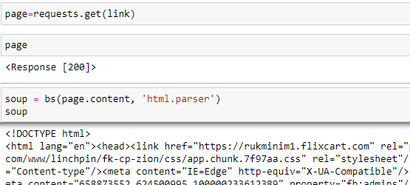
Data Scraping
Connection can be made using below commands we input the link object and make new object as page. when we run page command it should give <Response [200]> as output which confirms it was connected successfully and then we will parse the HTML so that HTML related content can be abstracted as given below

Slide 6
Data Scraping
The data that we extract is unstructured data. So we’ll create empty lists to store them in a structured form:
l_name=[] #List to store name of the product
l_price=[] #List to store price of the product
l_dis=[] #List to store discount on the product
l_rate=[] #List to store rating of the product
l_pack=[] #List to store Pack of the product
l_os=[] #List to store OS details of the product
l_disp=[] #List to store display details of the product
l_speaker=[] #List to store speaker capacity of the product
l_refreshrate=[] #List to store refresh rate of the product
l_inputsupport=[] #List to store inputs supported details of the product

Slide 7
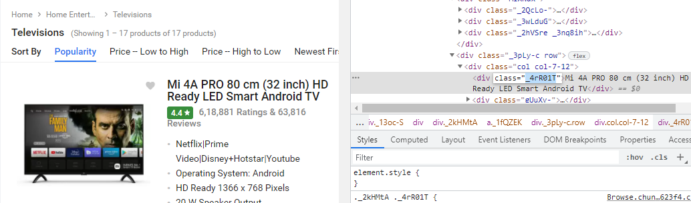
Data Scraping
Now we have to find the class in web page which we can use for fetching the data from web page by using below command, before that for finding the class name we have to open the web page in developer view and then capture the exact <div> tag which have the product name as shown below.
containers.find('div',class_='XXXX') :

Slide 8
Data Scraping
Once we store the data in list we have to ensure the length of them is same, post which we can store them in a structured form using pd.Dataframe(),
df=pd.DataFrame({'Product Name':l_name,'Price':l_price,'Discount':l_dis,'Rating':l_rate,'Pack':l_pack, 'OS':l_os,"Display":l_disp,"Speaker":l_speaker,"Refresh Rate":l_refreshrate,"Input Support":l_inputsupport})
Also we can store the data in xls file using df.to_excel("Scrapped_Data.xls", index=False).

Slide 9
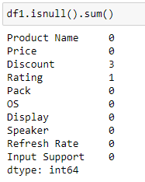
Data Cleaning/Formatting
Cleaning & updation of data in dataframe.
First we have to identify how much null values are there in dataframe.
As we can see there is entry with null value in Discount & Rating column.
We will update it by using below command
df1['Discount']=df1['Discount'].fillna(0)
As the discount is not provided hence we can say it is zero discount
and will update it as null however for rating we can use mode function
to give the rating because rating of the device cannot be Zero
m=df['Rating'].mode()
df1['Rating']=df1['Rating'].fillna(m[0])

Slide 10
Data Cleaning/Formatting
We also have to remove extra unwanted signs / spaces from the data. It can be achieved using replace & split command as given below:
df1['Price']=df1['Price'].replace({'₹':""},regex=True)
df1['Price'] = df1['Price'].replace({',' : ''}, regex=True)
df1['Discount']=df1['Discount'].str.split('%').str[0]
And once we have the whole value in columns in Price, Rating, Speaker, Refresh Rate, Discount we can make them numeric by below commands as per our need:
df1['Price']=df1['Price'].astype(float)
df1['Rating']=df1['Rating'].astype(float)
df1['Speaker']=df1['Speaker'].astype(int)
df1['Refresh Rate']=df1['Refresh Rate'].astype(float)
df1['Discount']=df1['Discount'].astype(int)

Slide 11
Data Cleaning/Formatting
We will check if there is any data type which is numeric type and available as object and then will typecast it to Numeric (i.e. int, float)
Now we can save clean dataframe into another xls file.
df1.to_excel("Clean Scrapped_Data.xls", index=False)

Slide 12
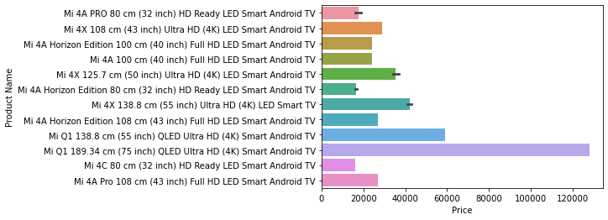
Data Visualisation
Once the data is saved in new excel we can use it for data visualisation
Now for data visualisation we will use seaborn library & matplotlib.
import seaborn as sns
import matplotlib.pyplot as plt
df2=pd.read_excel("Clean Scrapped_Data.xls")
sns.barplot(df2.Price,df2['Product Name'])

Slide 13
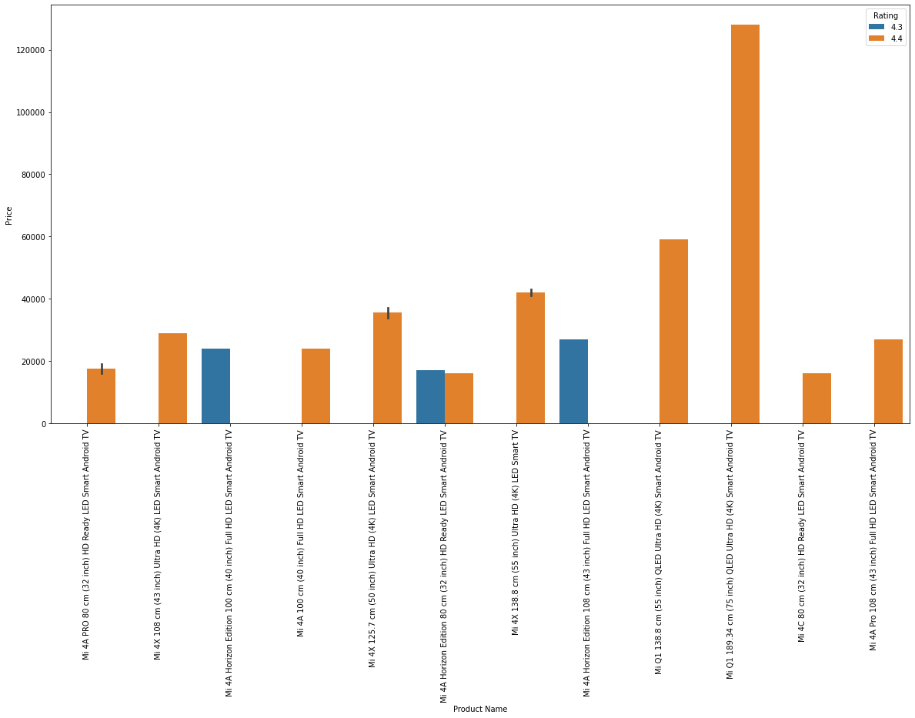
Data Visualisation
Also we can visualise the data by using different fields such as Product Name & Rating so that one can see which TV to choose basis on ratings
sns.barplot(df2['Product Name'],df2.Price,hue=df2['Rating'] )

Slide 14
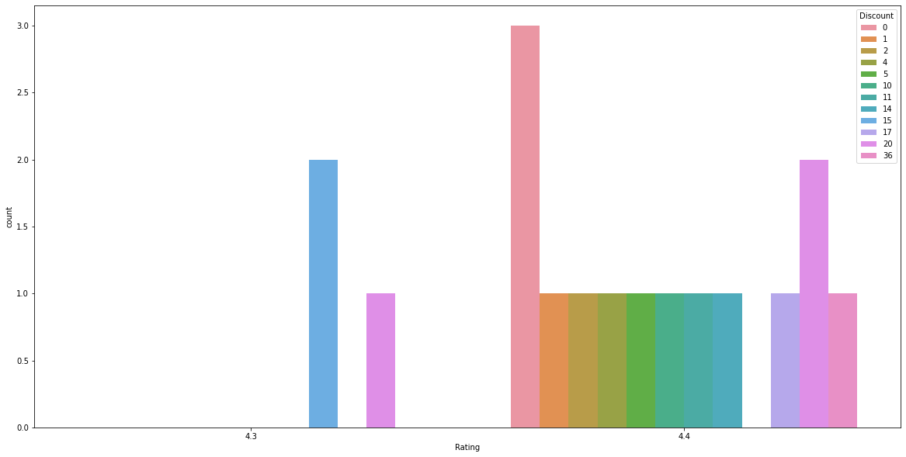
Data Visualisation
Also we can visualise the data by using different fields such as Discount & Rating so that one can see which TV to choose basis on ratings and price
sns.barplot(df2['Product Name'],df2.Price,hue=df2['Rating'] )

Slide 15
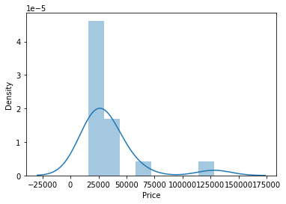
Data Visualisation
Also we can see the distribution of price of TV’s by using sns.distplot(df2.Price)

Slide 16
Thank you

